Slide 1
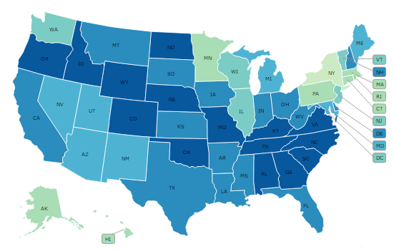
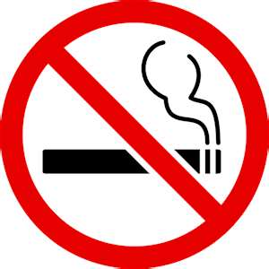
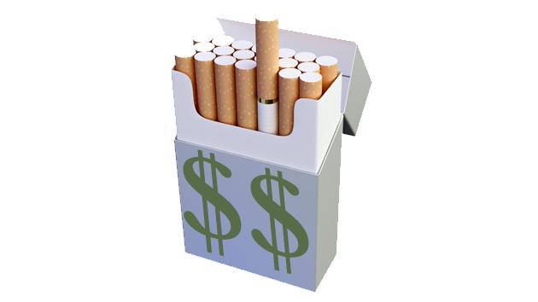
The SHG policy module: projecting the effects of tobacco control policies through microsimulation
CISNET Lung Group

Slide 2
The SHG Policy Module
Figure 1. The Smoking History Generator Policy Module
SHG yields smoking prevalence and mortality estimates
Policy module modifies initiation and cessation rates used by the SHG
Modifiers adjust for
Age
Year of policy implementation
Years since policy implementation
Initiation probability
All-cause mortality rate
Cessation probability
Initiation modifier
Cessation modifier
Simulate an
Individual’s
Life
Sample an
Individual
Derive prevalence, life years, and population deaths
Smoking history;
Initiation age,
Cessation age,
Age at death
No
Yes
All Individuals
Simulated
Notes:
The SHG simulates detailed individual-level smoking and other-cause mortality histories. It’s calibrated to data from the NHIS. For each person simulated, we can specify their year of birth, gender, and the SHG simulates their probability of smoking initiation, cessation, and death in any given year. From these individual life and smoking histories, we can obtain smoking prevalence and deaths at the population level.
In this work, we extend the CISNET SHG to evaluate the effects of policies. The way the policy module works is that it modifies those initiation and cessation probabilities used by the SHG, thus enabling the SHG to simulate individual smoking histories under a scenario where individual-level probabilities of smoking initiation decrease and smoking cessation probabilities increase.
So to evaluate the impact of a specific policy, we need to determine the appropriate initiation and cessation effect modifiers, and to vary those modifiers according to each individual’s age, when the simulated policy would go into effect, and how long its been since that policy was put into place.

Slide 3
1. Increasing cigarette taxes
Strongest evidence-base
Individuals at younger ages are more price-responsive
Highly effective tobacco control policy
Revenue generating
User inputs
Baseline scenario | Policy scenario | Policy start year
Initial price per pack of cigarettes ($initial price$): $4.00 to $10.00 | Tax increase ($tax$): $0.50 to $6.00 | 2016, 2017, 2018, 2019, 2020
% change in price
Notes:
The first policy, raising cigarette taxes, is also the tobacco control policy with the strongest evidence-base. The research has shown this to be a highly effective intervention, and it’s an attractive policy option for decision-makers because raising taxes on cigarettes actually generates state and local revenue.
The policy module for taxes requires 3 pieces of information. The first is the initial price per pack of cigarettes in that state or region, the second is the amount of tax increase, ranging from 50 cents to $6. These first two inputs provide us with the percent change in price. And finally the year in which the policy will be implemented.

Slide 4
Estimates
1. Cigarette taxes
Assumptions
Price elasticities by age group
Tax is passed on directly to consumers
Homogeneous price elasticity across price ranges
Initiation effects are constant going forward
Cessation effects decay over time
Model does not account for tax avoidance or evasion near state borders
Effect of the tax increase does not erode with inflation
Age group | Cessation elasticity* | Initiation elasticity*
Ages 10-17 | 2.00 | -0.4
Ages 18-24 |  | -0.3
Ages 25-34 |  | -0.2
Ages 35-64 |  | 0
Ages 65+ |  | 0
*due to the smaller number of studies examining initiation and cessation elasticities, these elasticities were developed to conform to and match prevalence elasticities
Notes:
The price elasticity represents the percent change in smoking relative to the percent change in price. So the cessation elasticity of 2 means that the model assumes that a 10% increase in price translates into a 20% increase in smoking cessation rates for individuals at all ages. However the effects of a 10% increase in price on initiation differs by age. Evidence shows that younger individuals are more responsive to changes in price, so we assume higher price elasticities for lower age groups such that for each 10% increase in price, initiation rates are reduced by 4% for ages 10-17, by 3% for ages 18-24, and by 2% for ages 25-34, with no impact on smoking initiation rages for those ages 35+.
We know that the effect of a policy is going to differ depending on whether the simulated individual is 15 or 45. At 15 the effect of a policy on smoking initiation is likely to be more important. Some policies, like tobacco taxes, we know that youth are more responsive to changes in the price of a pack of cigarettes.
We assume that whatever the tax increase is, that amount gets passed on directly to the consumer in the form of an increased price per pack of cigarettes. The price elasticities that we use to calculate the effects of policies are assumed to hold across all price ranges,
Whatever the change in price, the impact that it has on smoking initiation is assumed to continue going forward, whereas the effects of the policy on quitting will decay over time, as those who are inclined to quit smoking will have already done so in response to the policy.

Slide 5
Policy effects
1. Cigarette taxes
$${Init modifier}_{year n}=1−Init effect$$
$${Cess modifier}_{year n}= 1+Cess effect×{(1−d)}^{(year n−policy year)}$$
$$(\% change in price × elasticity)$$
$decay rate=\frac{(year n+1)}{(year n)}=0.2$
Notes:
The % change in price (as provided by the user) is multiplied by the corresponding price elasticities to calculate the policy effects on initiation and cessation.
Taking the percentage change in price applied to the initiation or cessation elasticity, this translates into policy effects that reduce individual initiation rates and increase cessation rates in response to the tax increase.
These effects are then translated into corresponding initiation and cessation modifiers for each age group. The effects of the tax on smoking cessation decay over time at rate $d$ with the majority of quitting taking place in the first few years immediately following policy implementation. The decay rate is based on the number of years since the policy was implemented. This process enables us to obtain the appropriate initiation and cessation modifiers for the policy module – that have been adjusted for the factors we discussed earlier: age, year of policy implementation, and how long its been since the policy was put into place.
$$cessation \left(or initiation\right) elasticity=$$
$$\frac{\% change in cessation \left(or initiation\right) rate}{\% change in price}$$

Slide 6
2. Smoke-free air laws
Strong evidence-base
Effective tobacco control policy
Essentially no costs
User inputs
Baseline scenario | Policy scenario | Policy start year
Percent of existing smoke-free air law coverage in workplaces, restaurants, bars (${pac}_{w,r,b})$: 0% to 100% | 100% coverage smoke-free air law applied to workplaces, restaurants, and/or bars $\left(I_{w,r,b}\right)$ | 2016, 2017, 2018, 2019, 2020
Notes:
The second policy we modeled was clean air laws or smoke-free air laws. These are also shown to be strong and effective tobacco control interventions. They also come at almost no cost to states.
For this policy, the user has to provide us with information about the existing smoke-free air law environment in their state or region. Smoke-free air laws tend to cover three types of venues: restaurants, bars, and worksites. So we need to know under the baseline scenario, the percent of the population covered by smoking bans in these types of venues – sometimes just because a state doesn’t have smoke-free worksites, private worksites have their own smoke-free policies. Likewise, if a state doesn’t ban smoking in bars, individual cities or municipalities might prohibit smoking in bars or restaurants.
Then we also need the user to provide us with information about what kind of smoke-free air law they want to implement. A comprehensive law would cover all three venues, but other laws might prohibit smoking in workplaces and restaurants but not bars. Then of course the user provides the year of policy implementation.

Slide 7
Estimates
2. Smoke-free air laws
Assumptions
Comprehensive laws reduce smoking prevalence by 10% within 5 years for working population
Retired population less affected by smoking bans in workplaces (reduced by 5% ages 65+)
With no existing coverage, comprehensive law reduces initiation rates by 10% and increases cessation by 50%
$${Pe}_{init}=0.10, {Pe}_{cess}=0.50$$
Relative effect of policy by venue
workplaces: ${Re}_{w}=\frac{6}{9}$
restaurants: ${Re}_{r}=\frac{2}{9}$
bars: ${Re}_{b}=\frac{1}{9}$
Initiation effects are constant going forward
Cessation effects decay over time
Model outcomes do not include the benefits of reduced secondhand smoke exposure
Notes:
Based on David Levy’s work and assessment of the evidence-base, we estimate that a comprehensive smoke-free air law that includes workplaces, restaurants, and bars reduces smoking prevlanece by 10% within 5 years for the working population, and by half that for the retired population who would no longer be affected by smoke-free workplaces. The policy module for smoke-free air laws was calibrated to achieve these targets, and from calibration assuming no existing level of smoke-free air law at baseline, a comprehensive ban is estimated to reduce initiation by 10% and cessation by 50%.
It’s assumed that the impact of smoke-free air laws is greatest in workplaces, followed by restaurants, and then by bars. Again we assume that the impact of these laws on smoking initiation rates stayed constant going forward, but that their impact on quitting declines over time as those who quit will do so in the years immediately following implementation.

Slide 8
Policy effects
2. Smoke-free air laws
Age-specific scaling factor
${Init modifier}_{year n}=1−Init effect$ $×A$
$${Cess modifier}_{year n}= 1+Cess effect×A{×(1−d)}^{(year n−policy year)}$$
$$\sum_{i=w,r,b}{Pe×I_{i}×{Re}_{i}×\left(1−{pac}_{i}\right)}$$
$decay rate=\frac{(year n+1)}{(year n)}=0.2$
Sum the relative effects across venue types and scale these based on the level of existing coverage
Notes:
These effects vary slightly by age, and during calibration of the smoke-free air law module, we applied individual age modifiers (as represented by the A here). In blue are the user inputs: that is the policy year, the percent of each venue type covered by existing smoke-free air policies, and which venues the policy would be applied to.
The way this is done is by summing the relative effects across each venue type – and to scale effects based on level of existing coverage of SFALs in workplaces, restaurants, bars:
0% to 100%. If a policy is not applied to a venue type, for example restaurants, then the Indicator variable here is set to zero, making the contribution of the policy to that venue type zero.
Once these policy effects are summed, they are applied to their corresponding age modifiers, and for cessation, adjusted based on the number of years it’s been since the policy was implemented.

Slide 9
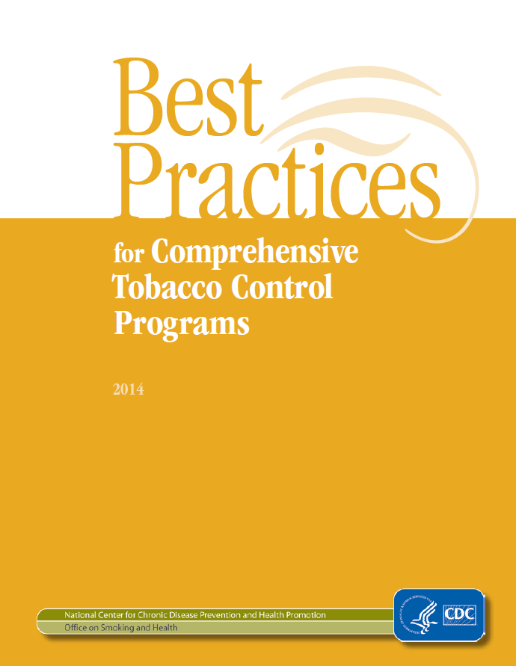
3. Increasing TC expenditures
Limited evidence on expenditures per se
Well-funded comprehensive, coordinated tobacco control programs can be effective
Costly to implement $$
User inputs
Baseline scenario | Policy scenario | Policy start year
Initial level of expenditures as % of CDC recommendation ($F_{init})$: 0% to 100% | Policy level of expenditures as 100% of CDC recommendation ($F_{final})$ | 2016, 2017, 2018, 2019, 2020
Notes:
The third policy we considered was increasing the level of tobacco control program expenditures, which I refer to as TC expenditures. While there is limited evidence on the impact of expenditures per se, we do know that well-funded comprehensive coordinated programs funded by these dollars can be effective. These coordinated programs can include cessation programs, media campaigns, state surveillance and evaluation, state and local-level initiatives including school-based programs.
Of the policies we model, this is the only one that would entail substantial costs to states. The CDC has issued its recommendations regarding the level of expenditures that states should invest in TC programming, and very few states meet these best practices.
The information we need as user inputs is the initial level of investment as a % of those CDC recommendations, and then the policy level of expenditures going up to 100% of CDC recommendations.

Slide 10
Estimates
3. TC expenditures
Assumptions
Level of investment is maintained
Initiation effects are constant going forward
Cessation effects decay over time
Increasing and then decreasing returns as the level of funding shifts from 0% to 100
Notes:
The module estimates that at most going from 0% to 100% of CDC funding recommendations increases cessation by 12.5% and decreases initiation by 10%. Other effects that start from a baseline scenario of 0% initial funding are shown in this figure here. You can see that as the level of funding reaches higher levels, the curve flattens such that the magnitude of effect sizes diminishes. So at the lowest and highest levels of funding, marginal effects are less pronounced, and it’s assumed in the middle range of funding, effects for a given relative change in funding is larger in magnitude. This is assumed because tobacco control programs will not be very effective at extremely low levels of funding, and that once you exceed a certain level of funding, the return on that investment at higher levels of existing expenditures is smaller.
For the policy being simulated, we assume that the specified level of funding is maintained each year.
Again, only the quitting rates decay over time, while the impact of expenditures remains constant going forward.

Slide 11
Policy effects
3. TC expenditures
${Init modifier}_{year n}=1−Init effect$
$${Cess modifier}_{year n}= 1+Cess effect{×(1−d)}^{(year n−policy year)}$$
$decay rate=\frac{(year n+1)}{(year n)}=0.2$
$$E\left(F_{final}\right)−E(F_{init})$$
Notes:
The policy’s effect sizes adhere to this same figure. So whatever the initial level of funding and the proposed level of funding being simulated, the effect size is the vertical distance between those two points for initiation and cessation respectively. For example if you’re starting from 20% and you go to 60% of CDC funding recommendations, the Initiation effect would be ~6%, while the cessation effect would be ~7%.
However you’ll see little to no change in smoking going from 90% to 100%. We’ll go through some of these results on the website later.

Slide 12
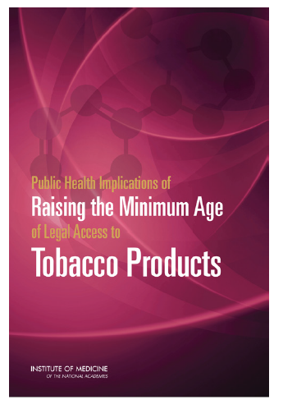
4. Minimum age of Legal Access
Limited evidence-base, few studies at local level
Effect sizes from the IOM are model assumptions
No costs involved
User inputs
Baseline scenario | Policy scenario | Policy start year
Percent of population already covered by MLA at age 19 or age 21 (${pac}_{19}, {pac}_{21})$: 0% to 100% | Raise MLA to age 19, 21, or 25 (${MLA}_{19, 21, or 25})$ | 2016, 2017, 2018, 2019, 2020
Notes:
The fourth policy we considered is raising the MLA. This is an attractive policy option to decision-makers because it involves no costs, and is being increasingly considered at both the local and state levels.
While there is evidence on the effectiveness of raising the legal drinking age, and other analogous interventions, the evidence-base on raising the MLA for tobacco isn’t substantial. We use the work and estimated effects from the IOM committee’s report.
Since now some states and localities have raised the MLA, if we want to take the existing policy environment into consideration, one of the inputs required is the percent of the population already covered by those MLA laws. Some individual states have 19 as the MLA rather than 18, so we take that into account to, since the impact of going from 19 to 21, will be different than from 18 to 21. The second input is the age at which the user would like to set the MLA, and we use the same ages proposed in the IOM report: 19, 21, or 25.

Slide 13
Estimates
4. MLA
Assumptions
Reduction in initiation by age group | Effect of raising the MLA
 | $$E_{19}$$ | $$E_{21}$$ | $$E_{25}$$
0-14 | 5% | 15% | 15%
15-17 | 10% | 25% | 30%
18 | 10% | 15% | 20%
19-20 | 0% | 15% | 20%
21-25 | 0% | 0% | 5%
No impact on cessation
Initiation effects are constant over time
Local MLA policies are not affected
Notes:
This policy is assumed to have no impact on cessation whatsoever. Which means that any changes to population smoking will take longer to realize. For this policy, we simulate results going out to 2100, whereas for the other policies we simulate through 2060. We also assume that policies at the local level are unaffected by policies implemented at the state level. So if a locality has an existing policy where the MLA is 21, then raising the MLA for the state up to 19 will have no effect on the population in that locality. However if a locality has an existing policy where the MLA is 19, then raising the state’s MLA to 21 will have an impact on that population.
The table here is taken directly from the IOM report, where the estimated effects of raising the minimum ages to 19, 21, and 25 are organized here by age group.

Slide 14
Policy effects
4. MLA
${Init modifier}_{year n}=1−Init effect$
Effect of increasing the MLA from 19 to 21
$${MLA}_{19}=E_{19}×\left(1−{pac}_{19} – {pac}_{21}\right)$$
$${MLA}_{21}=E_{21}×\left(1 – {pac}_{19} – {pac}_{21}\right)+\left(E_{21}−E_{19}\right)×\left({pac}_{19}\right)$$
$${MLA}_{25}=E_{25}×\left(1 – {pac}_{19} – {pac}_{21}\right)+\left(E_{25}−E_{19}\right)×\left({pac}_{19}\right)+\left(E_{25}−E_{21}\right)×\left({pac}_{21}\right)$$
$${pac}_{19}=\% of population already covered by MLA 19$$
$${pac}_{21}=\% of population already covered by MLA 21$$
Notes:
The way we operationalized this is by assuming that these effects are scaled according to the population not currently covered by an existing MLA policy. So the effects of raising the MLA to 19 are applied, and scaled down based on the percent of the population already covered by MLA 19 or MLA 21 in that state or region. When considering raising the minimum age to 21, however, the full effect of going from 18 to 21 is applied to the population not covered by existing laws at 19 or 21. However for individuals in that state covered by minimum age laws at 19, we take the difference in the effects at 21 and 19, and apply it to that population. When summed, this results in the overall initiation effect.
We use the same overall approach for raising the minimum age at 25 as well.

Slide 15
Model outcomes
Smoking prevalence
Deaths avoided
Calculate # of smoking-attributable deaths (SAD) in baseline vs. policy scenarios
Life years gained
Calculate total years of life lost (YLL) due to smoking in baseline and policy scenarios
Notes:
The SHG policy module and TCP tool provides with information smoking prevalence under the policy vs baseline scenario, the number of deaths avoided, and the number of life years gained.
To calculate the number of deaths avoided under the policy scenario compared to baseline, we follow this same approach that was used in the development of the IOM report. To calculate the number of deaths in a given scenario, the number of smoking-attributable deaths ($SAD$) are summed for both former smokers and current smokers across ages and genders. The total deaths are calculated by first multiplying the prevalences (${prev}_{cs, fs}$) by the corresponding population sizes ($P$) for each age group and gender, and then again by the difference in mortality rates between current or former smokers and never smokers ($μ_{cs,fs,ns}$) like so. This gives us the number of population deaths attributable to current smokers, and to former smoking. Then we calculate the number of deaths avoided under the policy scenario by taking difference in the total SADs between policy and baseline scenarios.

Slide 16
Deaths avoided
Calculate # of smoking-attributable deaths (SAD) in baseline vs. policy scenarios
# of population deaths attributable to current smoking
# of population deaths attributable to former smoking
$$SAD =\sum_{age,gender}{P×\left({prev}_{cs} ×\left(μ_{cs}−μ_{ns}\right)+{prev}_{fs} × \left(μ_{fs}−μ_{ns}\right)\right)}$$
Difference in mortality rate between former smokers and never smokers
Population size
Current smoker prevalence
Current smoker death rate
Notes:
The SHG policy module and TCP tool provides with information smoking prevalence under the policy vs baseline scenario, the number of deaths avoided, and the number of life years gained.
To calculate the number of deaths avoided under the policy scenario compared to baseline, we follow this same approach that was used in the development of the IOM report. To calculate the number of deaths in a given scenario, the number of smoking-attributable deaths ($SAD$) are summed for both former smokers and current smokers across ages and genders. The total deaths are calculated by first multiplying the prevalences (${prev}_{cs, fs}$) by the corresponding population sizes ($P$) for each age group and gender, and then again by the difference in mortality rates between current or former smokers and never smokers ($μ_{cs,fs,ns}$) like so. This gives us the number of population deaths attributable to current smokers, and to former smoking. Then we calculate the number of deaths avoided under the policy scenario by taking difference in the total SADs between policy and baseline scenarios.

Slide 17
Life years gained
Calculate total years of life lost (YLL) due to smoking in baseline and policy scenarios
$$YLL =\sum_{age,gender}{e_{ns}×P×\left({prev}_{cs} ×\left(μ_{cs}−μ_{ns}\right)+{prev}_{fs} × \left(μ_{fs}−μ_{ns}\right)\right)}$$
# of population deaths attributable to current smoking
# of population deaths attributable to former smoking
Life expectancy for never smoker at given age and gender
Notes:
This is similarly done for life years gained, however for each premature death of a current or former smoker at a given age, the number of life years lost due to smoking for that individual is the life expectancy for never smokers at that age ($e_{ns}$).
Thus, by applying the never smoker life expectancy to the number of smoking-attributable deaths at a given age, the total years of life lost ($YLL$) in the population can be calculated by the summing this value across all ages and genders. Life years gained are calculated by then subtracting the total years of life lost due to smoking under the policy scenario from the total under the baseline scenario.

Slide 18
State-level results
SHG policy module is based on nationally-representative data
National-level results directly scaled to the population sizes and smoking prevalence for 50 states + Washington, DC
State population sizes and smoking prevalence from 2015 Census Bureau and BRFSS
State-level estimates do not account for differences by geographic region or population heterogeneity across states
Notes:
Since most decision-making happens at the state level, we needed to re-scale our results. The SHG doesn’t simulate differences by geographic region and it doesn’t account for different demographic compositions across states. So we took national-level outputs from the SHG policy module and directly scaled that to the population sizes and smoking prevalence for each US state and Washington DC in 2015.

Slide 19
The Tobacco Control Policy (TCP) tool
Interactive web-based user interface
Targeted for decision-makers
Displays SHG policy module results
Scaled estimates for 50 states + DC
State-level data
Cigarette taxes: Campaign for Tobacco-Free Kids
Smoke-free air: Americans for Nonsmokers’ Rights
TC expenditures: CDC
MLA: Tobacco Twenty-One
www.tobaccopolicyeffects.org

Slide 20
References
Smoking History Generator
Jeon J, Meza R, Krapcho M, et al. Chapter 5: Actual and Counterfactual Smoking Prevalence Rates in the U.S. Population via Microsimulation. Risk Analysis 2012;32:S51-S68. doi: 10.1111/j.1539-6924.2011.01775.x
Moolgavkar SH, Holford TR, Levy DT, et al. Impact of reduced tobacco smoking on lung cancer mortality in the United States during 1975-2000. Journal of the National Cancer Institute 2012;104(7):541-8. doi: 10.1093/jnci/djs136 [published Online First: 2012/03/17]
Holford TR, Levy DT, McKay LA, et al. Patterns of birth cohort–specific smoking histories, 1965–2009. Am J Prev Med 2014;46(2):e31–e37.
Cigarette taxes
Smith K, Gilmore A, Chaloupka F, et al. IARC Handbooks of Cancer Prevention: Tobacco Control Volume 14 Effectiveness of Price and Tax Policies for Control of Tobacco. Lyon, France: International Agency for Research on Cancer 2011:31-90.
Contreary KA, Chattopadhyay SK, Hopkins DP, et al. Economic impact of tobacco price increases through taxation: a community guide systematic review. American journal of preventive medicine 2015;49(5):800-08.
Chaloupka FJ, Straif K, Leon ME. Effectiveness of tax and price policies in tobacco control. Tobacco control 2011;20(3):235-8. doi: 10.1136/tc.2010.039982 [published Online First: 2010/12/01]

Slide 21
References (cont.)
Cigarette taxes (cont.)
Chaloupka FJ, Yurekli A, Fong GT. Tobacco taxes as a tobacco control strategy. Tobacco Control 2012;21(2):172-80. [published Online First: 2012/02/22]
Warner KE. Death and taxes: using the latter to reduce the former. Tobacco Control 2014;23:4-6. doi: 10.1136/tobaccocontrol-2013-051079
Sung H, Hu T-w, Keeler TE. Cigarette taxation and demand: an empirical model. Contemporary Economic Policy 1994;12(3):91-100.
Ahmad S. Increasing excise taxes on cigarettes in California: a dynamic simulation of health and economic impacts. Prev Med 2005;41(1):276-83. doi: 10.1016/j.ypmed.2004.10.024 [published Online First: 2005/05/27]
Ahmad S, Franz GA. Raising taxes to reduce smoking prevalence in the US: a simulation of the anticipated health and economic impacts. Public Health 2008;122(1):3-10. doi: 10.1016/j.puhe.2007.02.020 [published Online First: 2007/07/06]
Emery S, Ake CF, Navarro AM, et al. Simulated effect of tobacco tax variation on Latino health in California. Am J Prev Med 2001;21(4):278-83. [published Online First: 2001/11/10]
Kaplan RM, Ake CF, Emery SL, et al. Simulated effect of tobacco tax variation on population health in California. Am J Public Health 2001;91(2):239-44. [published Online First: 2001/02/24]
Ohsfeldt RL, Boyle RG, Capilouto EI. Tobacco taxes, smoking restrictions, and tobacco use. National Bureau of Economic Research Working Paper Series 1998

Slide 22
References (cont.)
Cigarette taxes (cont.)
Levy DT, Cummings KM, Hyland A. Increasing Taxes as a Strategy to Reduce Cigarette Use and Deaths: Results of a Simulation Model. Preventive medicine 2000;31(3):279-86. doi: http://dx.doi.org/10.1006/pmed.2000.0696
The Community Preventive Services Task Force. Reducing Tobacco Use and Secondhand Smoke Exposure: Interventions to Increase the Unit Price for Tobacco Products 2014 [updated May 2014. Available from: https://www.thecommunityguide.org/findings/tobacco-use-and-secondhand-smoke-exposure-interventions-increase-unit-price-tobacco accessed May 29 2017.
Smoke-free air laws
Hopkins DP, Razi S, Leeks KD, et al. Smokefree Policies to Reduce Tobacco Use: A Systematic Review. American Journal of Preventive Medicine 2010;38(2, Supplement):S275-S89. doi: https://doi.org/10.1016/j.amepre.2009.10.029
Farkas AJ, Gilpin EA, Distefan JM, et al. The effects of household and workplace smoking restrictions on quitting behaviours. Tobacco control 1999;8(3):261-65.
Glasgow RE, Cummings KM, Hyland A. Relationship of worksite smoking policy to changes in employee tobacco use: findings from COMMIT. Community Intervention Trial for Smoking Cessation. Tobacco control 1997;6(suppl 2):S44.
Levy DT, Friend K, Polishchuk E. Effect of clean indoor air laws on smokers: the clean air module of the SimSmoke computer simulation model. Tobacco control 2001;10(4):345-51.

Slide 23
References (cont.)
Smoke-free air laws (cont.)
The Community Preventive Services Task Force. Reducing Tobacco Use and Secondhand Smoke Exposure: Smoke-free Policies 2013 [updated June 2013. Available from: https://www.thecommunityguide.org/findings/tobacco-use-and-secondhand-smoke-exposure-smoke-free-policies accessed May 29 2017.
Tobacco control expenditures
The Community Preventive Services Task Force. Reducing Tobacco Use and Secondhand Smoke Exposure: Comprehensive Tobacco Control Programs 2014 [updated September 2014. Available from: https://www.thecommunityguide.org/findings/tobacco-use-and-secondhand-smoke-exposure-comprehensive-tobacco-control-programs accessed May 29 2017.
Farrelly MC, Pechacek TF, Chaloupka FJ. The impact of tobacco control program expenditures on aggregate cigarette sales: 1981-2000. J Health Econ 2003;22(5):843-59. doi: 10.1016/s0167-6296(03)00057-2 [published Online First: 2003/08/30]
Tauras JA, Chaloupka FJ, Farrelly MC, et al. State tobacco control spending and youth smoking. Am J Public Health 2005;95(2):338-44. doi: 10.2105/ajph.2004.039727 [published Online First: 2005/01/27]
Farrelly MC, Pechacek TF, Thomas KY, et al. The impact of tobacco control programs on adult smoking. Am J Public Health 2008;98(2):304-9. doi: 10.2105/ajph.2006.106377 [published Online First: 2008/01/04]

Slide 24
References (cont.)
Tobacco control expenditures (cont.)
Centers for Disease Control and Prevention. Best Practices for Comprehensive Tobacco Control Programs—2014. Atlanta, GA: U.S. Department of Health and Human Services, Centers for Disease Control and Prevention, National Center for Chronic Disease Prevention and Health Promotion, Office on Smoking and Health, 2014.
Rhoads JK. The effect of comprehensive state tobacco control programs on adult cigarette smoking. J Health Econ 2012;31(2):393-405. doi: 10.1016/j.jhealeco.2012.02.005 [published Online First: 2012/03/31]
Raising the minimum age of legal access (MLA)
IOM (Institute of Medicine). Health Implications of Raising the Minimum Age for Purchasing Tobacco Products. Washington, DC: The National Academies Press, 2015.
Kessel Schneider S, Buka SL, Dash K, et al. Community reductions in youth smoking after raising the minimum tobacco sales age to 21. Tob Control 2016;25(3):355-9. doi: 10.1136/tobaccocontrol-2014-052207 [published Online First: 2015/06/14]
Preventing Tobacco Addiction Foundation. Tobacco Twenty-one State by State: List of all Tobacco 21 Cities 2017 [Available from: http://tobacco21.org/state-by-state/ accessed March 1 2017.

